Slide 1
Memory Management

Slide 2
Outline
Why Memory Management
Address Binding
Logical and Physical Address Spaces
Contiguous Allocation
Paging
Nachos Memory Management
Nachos User Programs and their Address Spaces
Current Nachos Memory Management

Slide 3
Why Memory Management
In order to run a user process, the operating system needs to：
allocate memory for the address space of the process, which consists of
text
initialized and uninitialized data
stack for procedure calls and returns
heap for dynamically allocated variables
de-allocate the memory for the address space, when the user process is deleted.
manage the entire physical memory for user processes so that processes can share it.

Slide 4
Why Memory Management
Requirements for Memory Management
address binding - determining the physical address for each memory reference in the program
sharing the physical memory between multiple user processes
protection from illegal access
preventing access from other processes
preventing illegal operation from within the process
efficient use of physical memory: minimizing memory fragmentation
fast access: do not slow down the memory access

Slide 5
Outline
Why Memory Management
Address Binding
Logical and Physical Address Spaces
Contiguous Allocation
Paging
Nachos Memory Management
Nachos User Programs and their Address Spaces
Current Nachos Memory Management

Slide 6
Address Binding
From Programs to Executables in Memory
programs to object modules: done by compiler
object modules to the load module: done by linker
the load module to the executable in memory: done by loader
Object Module
header: sizes and offsets of all sections
code: text of the program
initialized data
symbol table: external symbols
…
Notes:
目标文件中的符号表用来输出函数/变量符号信息，供连接时给其他模块引用。这种符号表中主要包含函数/变量的名称和地址对应关系 。
relocation information？

Slide 7
Address Binding
What is the load module we got?
It includes all the object modules (text and data).
All the external references are resolved.
It has a single address space starting from zero.
Loading a load module
copy the text and initialized data
expand the uninitialized data section
create a stack
create a heap for dynamically allocated variables

Slide 8
Address Binding
Address Space Binding of Relocatable Load Mode
static relocation
done at load time
address binding cannot change at run time
dynamic relocation
done at run time
supported by Memory Management Unit (MMU)

Slide 9
Outline
Why Memory Management
Address Binding
Logical and Physical Address Spaces
Contiguous Allocation
Paging
Nachos Memory Management
Nachos User Programs and their Address Spaces
Current Nachos Memory Management

Slide 10
Logical and Physical Address Spaces
Logical Address and its Space
addresses issued by the CPU
Physical Address and its Space
addresses seen by the memory unit
real addresses of the instructions and data

Slide 11
Logical and Physical Address Spaces
Logical Address = Physical Address, if
static relocation is done at load time
Logical Address != Physical Address, if
dynamic relocation is at rum time
supported by relocation register
Memory Management Unit
hardware device
support mapping of logical to physical address space

Slide 12
Outline
Why Memory Management
Address Binding
Logical and Physical Address Spaces
Contiguous Allocation
Paging
Nachos Memory Management
Nachos User Programs and their Address Spaces
Current Nachos Memory Management

Slide 13
Contiguous Allocation
Classical Dynamic Storage Allocation Problem
given
single partition of storage space (memory)
input queue of processes (job queue), each requiring a storage for its address space
Free Storage Management
list of free space of contiguous memory (holes)
devise an algorithm to satisfy as many as jobs as possible

Slide 14
Contiguous Allocation
Data Structure
List of holes (free space management)
Input job queues
Basic algorithm
Find a hole to match a job from the input queue
Split the hole and return the unused (smaller) hole back to the list
Merge the adjacent holes when the job is completed
Problem
fragmentation and compaction
Notes:
连续分配方式会形成许多“碎片”，虽然可以通过“紧凑”方法将碎片拼接成可用的大块空间，但须为此付出很大开销。如果允许将一个进程直接分散地分配到不相邻的分区中，就不必再进行“紧凑”，基于这一思想而产生了离散分配方式。

Slide 15
Outline
Why Memory Management
Address Binding
Logical and Physical Address Spaces
Contiguous Allocation
Paging
Nachos Memory Management
Nachos User Programs and their Address Spaces
Current Nachos Memory Management

Slide 16
Paging
What is Paging?
Another way of mapping of logical address to physical address
to eliminate external fragmentation and compaction
Mechanism
Frames: fixed-size blocks of physical address space, normally in powers of two
Pages: fixed-size blocks of the same size in logical address space
page table: mapping pages to frames
Non-contiguous mapping
The page frames of an address space do not have to be contiguous.
Needs fast address translation (page table can be large and needs to be in memory)

Slide 17
Paging
Physical Address Space
address space size: 2^{k} bytes
page frame size: 2^{n} bytes (n < k)
turning linear address, a, into a pair (f, d):
f: frame number
d: displacement
f = a div 2^{n} (k - n bits)
d = a mod 2^{n} (n bits)

Slide 18
Paging
Logical Address Space
address space size: 2^{m} bytes
page size: 2^{n} bytes (n < m)
turning linear address, l, into a pair (p, d):
p: page number
d: displacement
p = l div 2^{n} (m - n bits)
d = l mod 2^{n} (n bits)
Page Table
mapping page number p to frame number f

Slide 19
Paging
Implementation of Paging
extract p from logical address l
extract d from logical address l
map p to f using page table
assemble physical address a using (f, d)

Slide 20
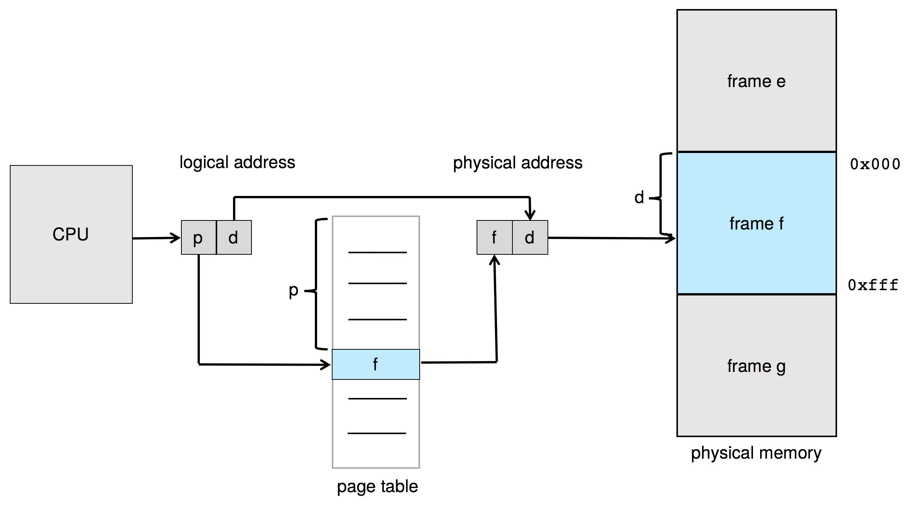
Paging Hardware
页表也存储在物理内存中

Slide 21
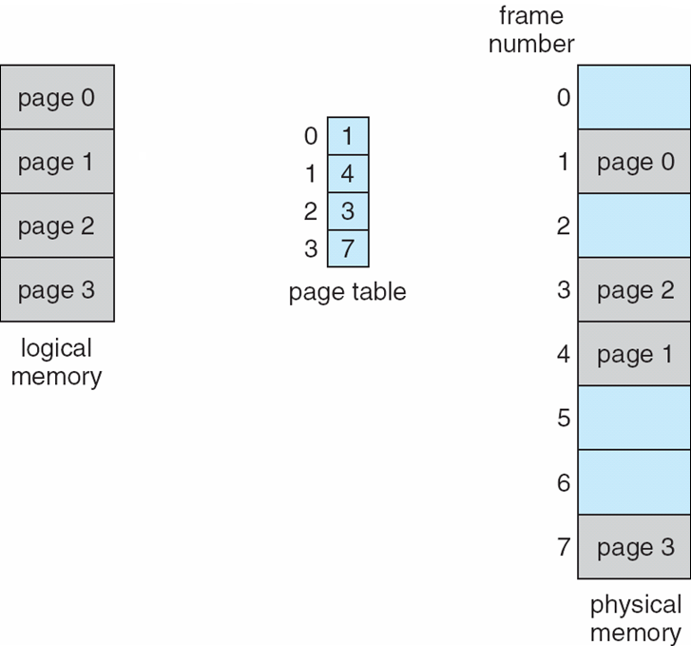
Paging Model of Logical and Physical Memory

Slide 22
Paging
User Process Page Tables
each user process has a page table
need to be saved and restored during the context switch

Slide 23
Paging
Problems with Paging
two memory accesses for each logical address
page table access
physical address access
Hardware Support with TLB
Translation Look-aside Buffer (TLB)
fast associate memory (registers)
addressed by contents
entry: pair (p, f )
Notes:
TLB 后备转换缓冲器

Slide 24
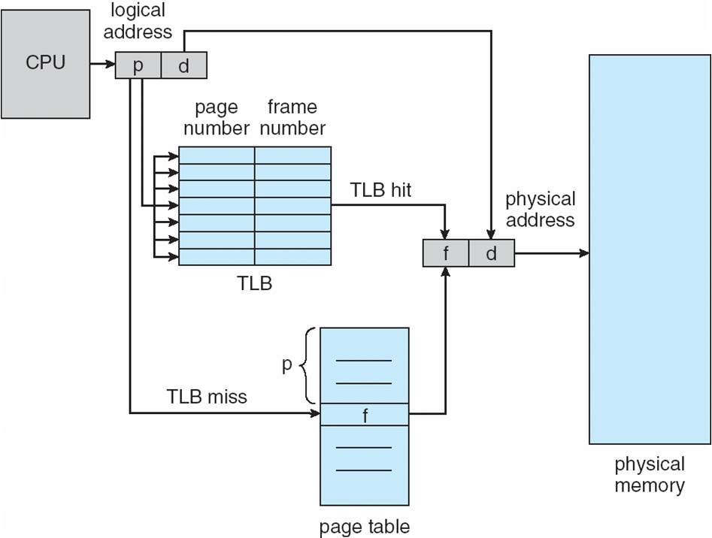
Paging Hardware with TLB

Slide 25
Paging
caching translation
store recent translations
TLB hit: translation for p exists in TLB
TLB miss: translation for p does not exits in TLB and store the translation
If TLB is full when a TLB miss occurs, replace one of the entries with the new translation.
effective memory access time
ea = H (ta + ma) + (1- H) *(ta + 2 *ma)
H: TLB hit ratio
ta: TLB table look up time
ma: memory access time
Notes:
2* ma ------page table entry + desired data in memory?

Slide 26
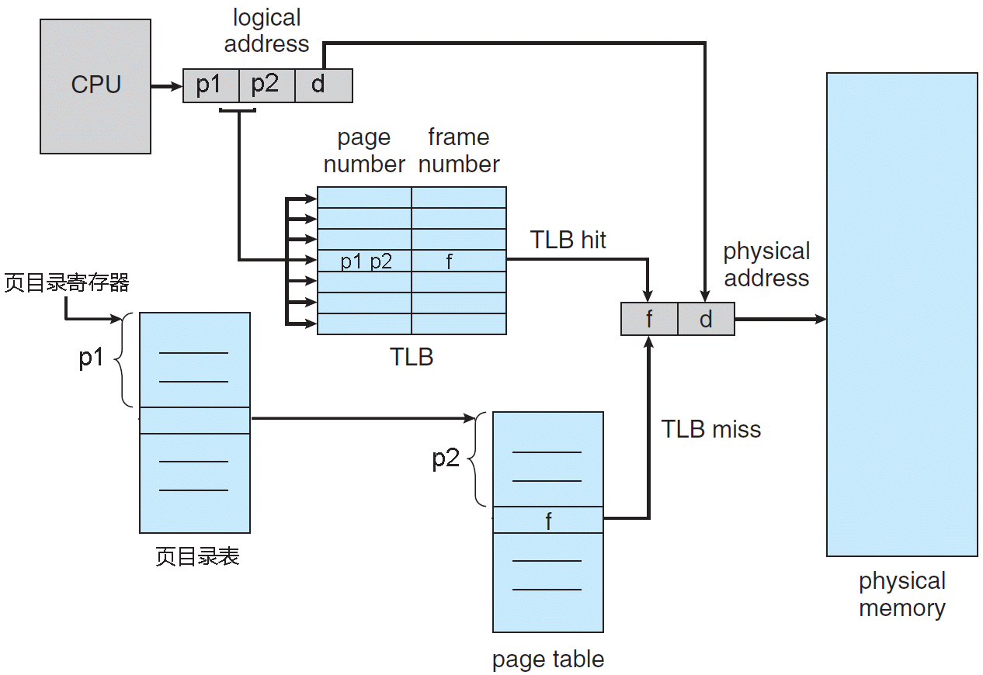
2 Stage Page Table with TLB

Slide 27
Outline
Why Memory Management
Address Binding
Logical and Physical Address Spaces
Contiguous Allocation
Paging
Nachos Memory Management
Nachos User Programs and their Address Spaces
Current Nachos Memory Management

Slide 28
Nachos User Programs and their Address Spaces
User Programs of Nachos
Nachos uses a MIPS simulator to run user programs
The gcc MIPS cross-compiler is used to translate user programs to load modules for MIPS.
Procedure to Make Nachos User Programs
Compile user programs in C to object modules for MIPS
Compile the start program start.s into the object module for MIPS
Link the object modules to the load module using UNIX COFF format
Convert the load module to use the Nachos executable format -NOFF

Slide 29
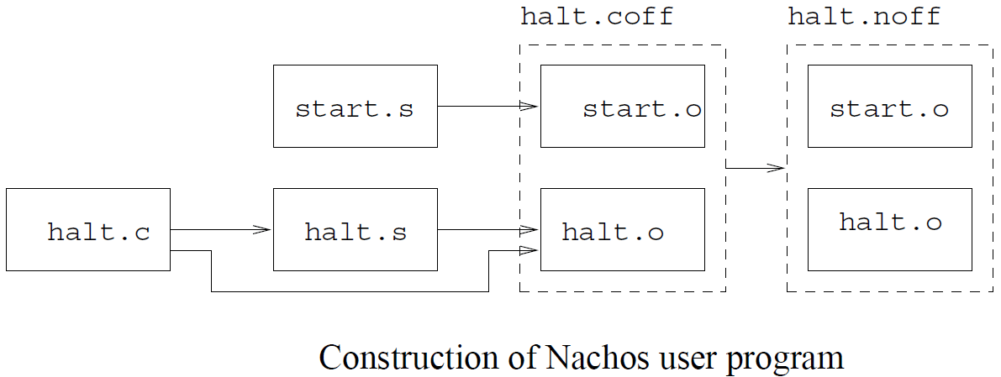
Nachos User Programs and their Address Spaces

Slide 30
Nachos User Programs and their Address Spaces
Nachos NOFF format (../bin/noff.h)
#define NOFFMAGIC 0xbadfad // magic number denoting Nachos object code file
typedef struct segment {
int virtualAddr; /* location of segment in virt addr space */
int inFileAddr; /* location of segment in this file */
int size; /* size of segment */
} Segment;
typedef struct noffHeader {
int noffMagic; /* should be NOFFMAGIC */
Segment code; /* executable code segment */
Segment initData; /* initialized data segment */
Segment uninitData; // uninitialized data segment, should be zero'ed before use
} NoffHeader;

Slide 31
Nachos User Programs and their Address Spaces
From Nachos Threads to Nachos User Processes
A Nachos user process is a Nachos thread with
user address space
user-level register state
Additional definitions in Thread.h
#ifdef USER_PROGRAM
// A thread running a user program actually has *two* sets of CPU registers --
// one for its state while executing user code, one for its state
// while executing kernel code.
int userRegisters[NumTotalRegs]; // user-level CPU register state
public:
void SaveUserState(); // save user-level register state
void RestoreUserState(); // restore user-level register state
AddrSpace *space; // User code this thread is running.
#endif

Slide 32
Nachos User Programs and their Address Spaces
The actual address of the user process has to be constructed before the user process can run
void StartProcess(char *filename) {
OpenFile *executable = fileSystem->Open(filename);
AddrSpace *space;
if (executable == NULL) {
printf("Unable to open file %s\n", filename);
return;
}
space = new AddrSpace(executable);
currentThread->space = space;
delete executable; // close file
space->InitRegisters(); // set the initial register values
space->RestoreState(); // load page table register
machine->Run(); // jump to the user progame
ASSERT(FALSE); // machine->Run never returns;
// the address space exits by doing the syscall "exit"
}

Slide 33
Nachos User Programs and their Address Spaces
MIPS Simulator in Nachos
The execution of Nachos user programs is simulated on a MIPS simulator.
The MIPS machine simulated has the following components:
User Registers: the registers used by user programs
Main Memory: the physical memory of the machine for all user programs
TLB: a Table Look ahead Buffer
Page Table: a pointer to the current page table
char *mainMemory; // physical memory to store user program,
// code and data, while executing
int registers[NumTotalRegs];
TranslationEntry *tlb; // this pointer should be considered
// "read-only" to Nachos kernel code
TranslationEntry *pageTable;

Slide 34
Nachos User Programs and their Address Spaces
Page Table and Address Space of Nachos User Process
Page table and TLB share the same structure for table entries
class TranslationEntry {
public:
int virtualPage; // The page number in virtual memory.
int physicalPage; // The page number in real memory (relative to the
// start of "mainMemory"
bool valid; // If this bit is set, the translation is ignored.
// (In other words, the entry hasn't been initialized.)
bool readOnly; // If this bit is set, the user program is not allowed
// to modify the contents of the page.
bool use; // This bit is set by the hardware every time the
// page is referenced or modified.
bool dirty; // This bit is set by the hardware every time the
// page is modified.
};

Slide 35
Nachos User Programs and their Address Spaces
Address Space Class AddrSpace
contains the page table of the user process
class AddrSpace {
public:
...
private:
TranslationEntry *pageTable; // Assume linear page table
// translation for now!
unsigned int numPages; // Number of pages in the virtual
// address space
};

Slide 36
Nachos User Programs and their Address Spaces
How is the program loaded into memory to form the address space?
AddrSpace::AddrSpace(OpenFile *executable) {
NoffHeader noffH;
unsigned int i, size;
executable->ReadAt((char *)&noffH, sizeof(noffH), 0);
if ((noffH.noffMagic != NOFFMAGIC) &&
(WordToHost(noffH.noffMagic) ==NOFFMAGIC))
SwapHeader(&noffH);
ASSERT(noffH.noffMagic == NOFFMAGIC);
// how big is address space?
size = noffH.code.size + noffH.initData.size + noffH.uninitData.size
+ UserStackSize; // we need to increase the size to leave room for the stack
numPages = divRoundUp(size, PageSize);
size = numPages * PageSize;

Slide 37
Nachos User Programs and their Address Spaces
ASSERT(numPages <= NumPhysPages); // check we're not trying to run anything too big
// --at least until we have virtual memory
DEBUG('a', "Initializing address space, num pages %d, size %d\n", numPages, size);
// first, set up the translation
pageTable = new TranslationEntry[numPages];
for (i = 0; i < numPages; i++) {
pageTable[i].virtualPage = i; // for now, virtual page # = phys page #
pageTable[i].physicalPage = i;
pageTable[i].valid = TRUE;
pageTable[i].use = FALSE;
pageTable[i].dirty = FALSE;
pageTable[i].readOnly = FALSE; // if the code segment was entirely on a separate page,
// we could set its pages to be read-only
}
// zero out the entire address space, to zero the uninitialized data segment
// and the stack segment
bzero(machine->mainMemory, size);

Slide 38
Nachos User Programs and their Address Spaces
// then, copy in the code and data segments into memory
if (noffH.code.size > 0) {
DEBUG('a', "Initializing code segment, at 0x%x, size %d\n",
noffH.code.virtualAddr, noffH.code.size);
executable->ReadAt(&(machine->mainMemory[noffH.code.virtualAddr]),
noffH.code.size, noffH.code.inFileAddr);
}
if (noffH.initData.size > 0) {
DEBUG('a', "Initializing data segment, at 0x%x, size %d\n",
noffH.initData.virtualAddr, noffH.initData.size);
executable->ReadAt(&(machine->mainMemory[noffH.initData.virtualAddr]),
noffH.initData.size, noffH.initData.inFileAddr);
}
}

Slide 39
Outline
Why Memory Management
Address Binding
Logical and Physical Address Spaces
Contiguous Allocation
Paging
Nachos Memory Management
Nachos User Programs and their Address Spaces
Current Nachos Memory Management

Slide 40
Current Nachos Memory Management
Current Nachos
always maps frame i to page i
cannot load more than one user process
does not use free storage management
is not truly multiprogramming yet

Slide 41
Current Nachos Memory Management
Memory accesses simulated by functions
Machine::ReadMem(int addr, int size, int *value)
Machine::WriteMem(int addr, int size, int value)
addr -logical address issued by CPU(MIPS)
The Nachos memory management uses paging with TLB.
Support by the Memory Management Unit (MMU) simulated by function
Machine::Translate(int virtAddr,int* physAddr,int size, bool writing)

Slide 42
Current Nachos Memory Management
ExceptionType
Machine::Translate(int virtAddr, int* physAddr, int size, bool writing) {
int i;
unsigned int vpn, offset;
TranslationEntry *entry;
unsigned int pageFrame;
DEBUG('a', "\tTranslate 0x%x, %s: ", virtAddr, writing ? "write" : "read");
// check for alignment errors
...
// we must have either a TLB or a page table, but not both!
...

Slide 43
Current Nachos Memory Management
// calculate the virtual page number, and offset within the page,
// from the virtual address
vpn = (unsigned) virtAddr / PageSize;
offset = (unsigned) virtAddr % PageSize;
if (tlb == NULL) { // => page table => vpn is index into table
if (vpn >= pageTableSize) {
DEBUG('a', "virtual page # %d too large for page table size %d!\n",
virtAddr, pageTableSize);
return AddressErrorException;
}

Slide 44
Current Nachos Memory Management
else if (!pageTable[vpn].valid) {
DEBUG('a', "virtual page # %d too large for page table size %d!\n",
virtAddr, pageTableSize);
return PageFaultException;
}
entry = &pageTable[vpn];

Slide 45
Current Nachos Memory Management
}
else {
for (entry = NULL, i = 0; i < TLBSize; i++)
if (tlb[i].valid && ((unsigned int)tlb[i].virtualPage == vpn)) {
entry = &tlb[i]; // FOUND!
break;
}
if (entry == NULL) { // not found
DEBUG('a', "*** no valid TLB entry found for this virtual page!\n");
return PageFaultException; // really, this is a TLB fault, the page may be
// in memory, but not in the TLB
}
}

Slide 46
Current Nachos Memory Management
if (entry->readOnly && writing) { // trying to write to a read-only page
DEBUG('a', "%d mapped read-only at %d in TLB!\n", virtAddr, i);
return ReadOnlyException;
}
pageFrame = entry->physicalPage;
// if the pageFrame is too big, there is something really wrong!
// An invalid translation was loaded into the page table or TLB.
if (pageFrame >= NumPhysPages) {
DEBUG('a', "*** frame %d > %d!\n", pageFrame, NumPhysPages);
return BusErrorException;
}

Slide 47
Current Nachos Memory Management
entry->use = TRUE; // set the use, dirty bits
if (writing)
entry->dirty = TRUE;
*physAddr = pageFrame * PageSize + offset;
ASSERT((*physAddr >= 0) && ((*physAddr + size) <= MemorySize));
DEBUG('a', "phys addr = 0x%x\n", *physAddr);
return NoException;
}

Slide 48
Thanks!

